Slide 1
Embodied AI week 14
- Shaoqin Li

Slide 2
Dexterous Hand
One of the reason for training humanoids is to have them to replicate human tasks
A factor that prevents them doing so is their hands – most of the humanoids now come with simple two-finger grippers, which can not handle complex hand tasks

Slide 3
Options
There are three tiers in this market right now. Tier one is mass production — hands you can buy off a shelf or through a distributor. Tier two is research-lab scale — premium hardware with long lead times and high prices. Tier three is demo-stage — impressive at conferences, limited commercial availability.
For now, I am going to introduce Unitree Dex5 and Inspire Robots RH56 series

Slide 4
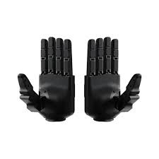
Unitree Dex5
Has Dex5-1 and Dex5-1pro variants
Released in April 2025
20 degrees of freedom — 16 active and 4 passive
Each finger has its own force-controlled micro joints
Pros:
Same ecosystem: easy integration
High communication rate
Cons:
No research papers on it
The 4 passive DOF also means some finger motions are mechanically coupled rather than independently actuated, which constrains the space of manipulation behaviors the hand can execute compared to a fully actuated hand
No price listed yet

Slide 5
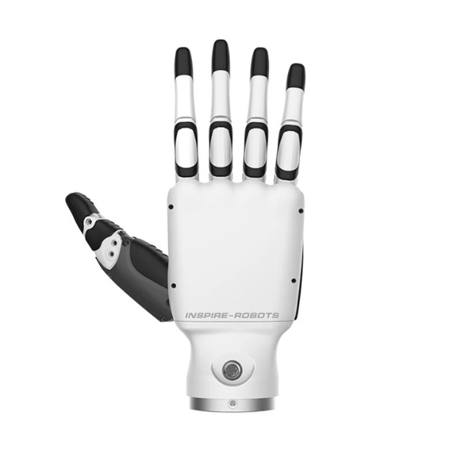
Inspire Robots RH56 Series
Created by Inspire Robots, a Beijing-based company that has been in the dexterous hand space
Has 6 active degrees of freedom and 12 joints
Integrate force sensors and use linear servo actuators
compatibility with the Unitree G1
Pros:
Mature production, can order right away and prices are available
many research papers are using its product
Cons:
Limited DOF: only 6 active DOF
Integration on R1 remains in question

Slide 6
Dexterous Hand paper: Learning Dexterous In-Hand Manipulation by OpenAI
https://arxiv.org/abs/1808.00177
Training dexterous hand in physical world used to be impractical, but this paper gives a great start
This paper's core idea is to train entirely inside a computer simulation and then transfer that learned policy to a real robot. The trick is to make the simulator deliberately unpredictable, randomizing friction, weight, lighting, and camera angles, so the policy can't memorize one specific simulated world but must learn principles general enough to work anywhere. Combined with massive distributed computing — 384 machines running simultaneously — and a memory-equipped neural network, the result is a Shadow Dexterous Hand that can reorient a block in its fingers hundreds of times in a row.
This matters because it proved, for the first time, that contemporary RL algorithms could solve a dexterous manipulation problem on a real five-fingered hand — without a single human demonstration. It opened the door to the entire 2025–2026 wave of dexterous hand research that followed.

Slide 7
Core challenges
The Reality Gap
A simulated hand has perfect joints, no cable stretch, no temperature effects, and no electrical noise. A real hand has all of these. A policy that learns the exact physics of the simulation will fail catastrophically on the real robot
Sample Complexity
The amount of randomized data used in simulation requires massive distributed hardware
Memory and Adaptation
Each trial begins with unknown physical properties. A memoryless policy that always makes the same move in the same situation cannot adapt to a robot that behaves slightly differently every time it's turned on.
Sensing Limitations
The Shadow Hand has many sensors, but most of them — touch sensors, Hall effect joint sensors — are too noisy and hardware-specific to model reliably in simulation.

Slide 8
Core Framework
The system has four interlinked components working like a film crew producing a live broadcast.
simulator
a MuJoCo physics environment of the Shadow Hand, but deliberately randomized at the start of every episode: friction, mass, joint damping, gravity direction, lighting, and texture all vary.
control policy
LSTM recurrent neural network. It takes fingertip positions and object orientation as input and outputs 20 joint angle adjustments. Crucially, it uses an Asymmetric Actor-Critic setup: the training helper network (critic) sees privileged information like exact joint velocities that the deployed policy cannot, making training more efficient without cheating at deployment time.
vision model
convolutional neural network trained only on synthetic images — no real photos at all. It uses three camera feeds simultaneously to estimate the 3D pose of the object, resolving ambiguities that a single camera would miss
distributed training with Rapid
384 CPU machines generate experience by playing out the policy in randomized simulations, while 8 GPUs continuously update the policy parameters using PPO

Slide 9
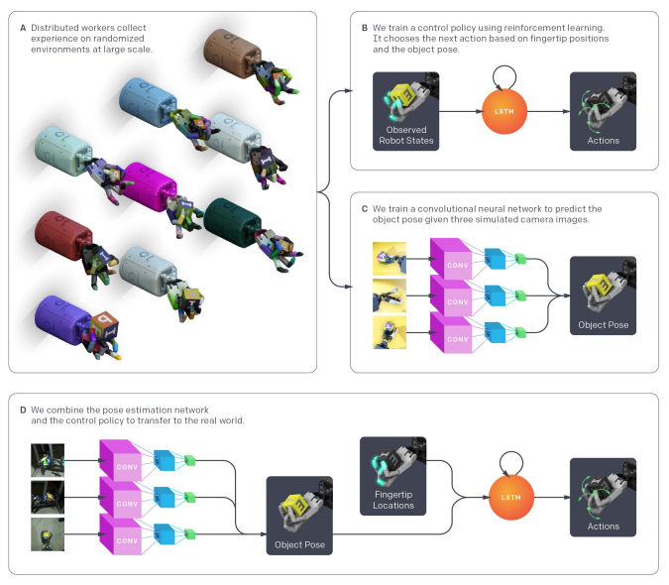
Images of core framework
System Overview. (a) We use a large distribution of simulations with randomized parameters and appearances to collect data for both the control policy and vision-based pose estimator. (b) The control policy receives observed robot states and rewards from the distributed simulations and learns to map observations to actions using a recurrent neural network and reinforcement learning. (c) The vision based pose estimator renders scenes collected from the distributed simulations and learns to predict the pose of the object from images using a convolutional neural network (CNN), trained separately from the control policy. (d) To transfer to the real world, we predict the object pose from 3 real camera feeds with the CNN, measure the robot fingertip locations using a 3D motion capture system, and give both of these to the control policy to produce an action for the robot.

Slide 10
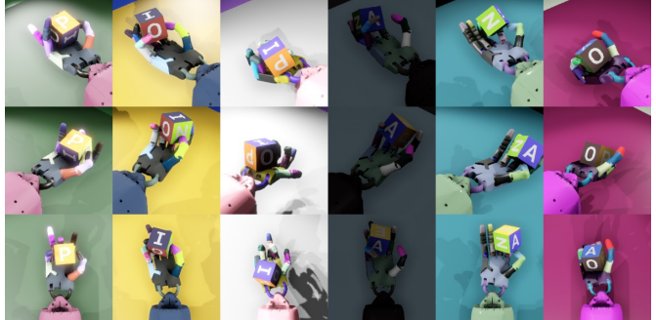
Images of core framework cont
Simulations with different randomized visual appearances. Rows correspond to the renderings from the same camera, and columns correspond to renderings from 3 separate cameras which are simultaneously fed into the neural network.

Slide 11
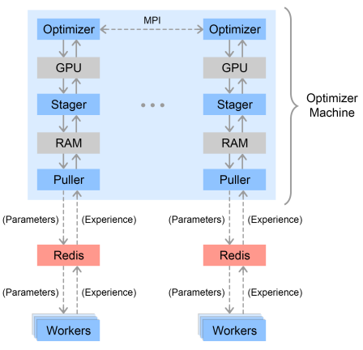
Images of core framework cont
Our distributed training infrastructure in Rapid. Individual threads are depicted as blue squares. Worker machines randomly connect to a Redis server from which they pull new policy parameters and to which they send new experience. The optimizer machine has one MPI process for each GPU, each of which gets a dedicated Redis server. Each process has a Puller thread which pulls down new experience from Redis into a buffer. Each process also has a Stager thread which samples minibatches from the buffer and stages them on the GPU. Finally, each Optimizer thread uses a GPU to optimize over a minibatch after which gradients are accumulated across threads and new parameters are sent to the Redis servers.

Slide 12
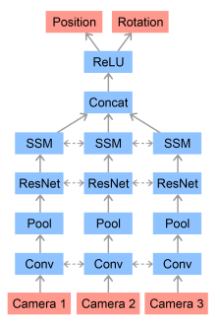
Images of core framework cont
Vision network architecture. Camera images are passed through a convolutional feature stack that consists of two convolutional layers, max-pooling, 4 ResNet blocks [24], and spatial softmax (SSM) [19] layers with shared weights between the feature stacks for each camera. The resulting representations are flattened, concatenated, and fed to a fully connected network. All layers use ReLU [41] activation function. Linear outputs from the last layer form the estimates of the position and orientation of the object.

Slide 13
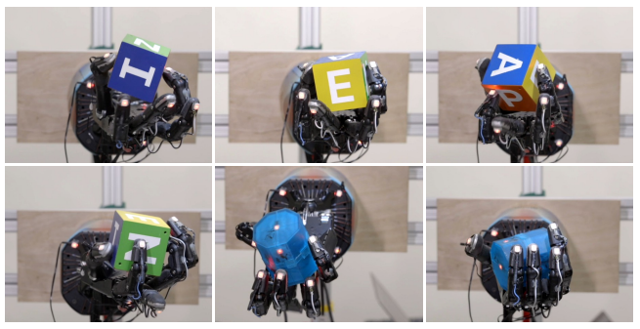
Experiment Results
Different grasp types learned by our policy. From top left to bottom right: Tip Pinch grasp, Palmar Pinch grasp, Tripod grasp, Quadpod grasp, 5-Finger Precision grasp, and a Power grasp.

